Slide 1
Hi I’m Drupal how can I help you?
gambry
DrupalCamp London
3rd March 2018

Slide 2

ABOUT ME
Hi, I’m:
Gabriele / Gabi / gambry
15+ PHP / 10+ Drupal
Lead Drupal Engineer/Consultant @ MANIFESTO
I Like:
Drupal, PHP, Javascript, Deployment, Performance
Chatbots and Personal Assistants, Encryption
Altered Carbon

Slide 3

SERVING YOUR CONTENT
Website
Social Media
RSS
RESTful
Mobile App
Mail
Notes:
Node/Content, Configuration, Menu items
Not – easily – reusable across projects
Not meant to be extendible

Slide 4
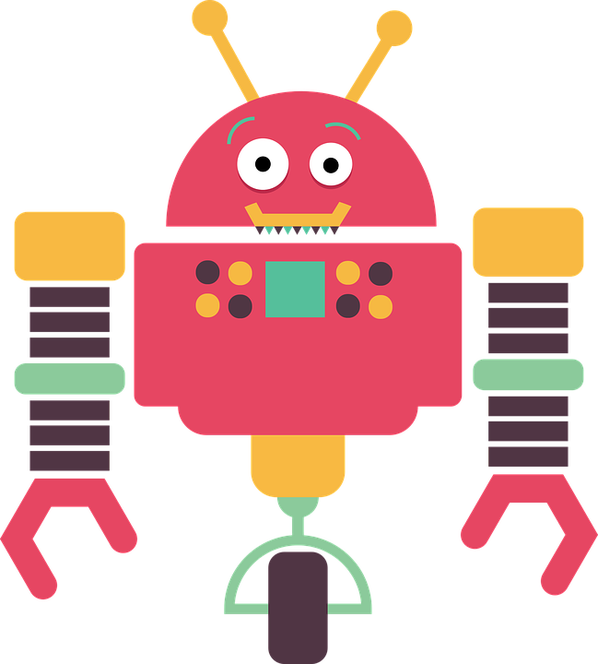

CHATBOTS &
PERSONAL ASSISTANTS
Notes:
PHP, OOP.

Slide 5

CONVERSATIONAL INTERFACES
How can I get some HELP?
Have you tried on OUR PORTAL?
No. Where about specifically?
Follow this LINK.
Thanks, can you save it
on my FAVOURITES?
Done! I’ve added it to
your DASHBOARD.
Notes:
PHP, OOP.

Slide 6
How can I register to an event?
When is Run for Fun 2018 going to happen?
What’s on Camden Town this weekend?
FAQs
Campaigns
Events
Use the tab “Register” (on the right for Desktop, the last section on mobile). You will find the registration form in there.
“The Dreamers” are playing at The Camden Lock, Sat 9pm. Tickets from 10£. Do you want to know more or skip to next event?
Tuesday the 29th of May. Check out all the details.
Best properties near Shoreditch.
How can I get my boiler fixed?
Latest news about cinema?
Search
Support
News
Based on your latest preferences, I’ve emailed you your best matches for properties in Shoreditch
Call 00112233 from your registered mobile, then press 8 to book a technician.
“Matrix, again”
Rating: Imdb 8.5/10, RT 4.5/5
Say skip to scroll to next result.
Notes:
Full richtext responses, including Images, Video where available.

Slide 7

NATURAL-LANGUAGE PROCESSING
How can I get my boiler fixed?
What’s the user INTENT
Extract known ENTITIES from user request
Understand and manage the current CONTEXT
Notes:
NLP: Alexa, DialogFlow, Watson, Chatfuel, Conversable
Intent: The user needs support & maintenance
Entities: Boiler
Context: User Account, Previous request or details.
NEXT: Intents & Utterances

Slide 8
NLP: INTENTS
How can I get my boiler fixed?
MAINTENANCE REQUEST
Can you fix my boiler?
I need my boiler fixed.
I need you to fix my boiler.
How can I get my boiler fixed?
How can I fix my boiler.
My boiler needs to be fixed.
Fix my boiler!
...
Notes:
NLP: Alexa, DialogFlow, Watson, Chatfuel, Conversable
Intent: The user needs support & maintenance
Entities: Boiler
Context: User Account, Previous request or details.
NEXT: Intents & Utterances

Slide 9
NLP: ENTITIES
How can I get my boiler fixed?
How can I get my @appliance @task.
INTENT: Maintenance Request
ENTITIES: Appliance “Boiler”
Task “Repair”
Entity Placeholder
Can you @task my @appliance?
I need my @appliance @task.
I need you to @task my @appliance.
How can I get my @appliance @task?
How can I @task my @appliance.
My @appliance needs to be @task.
@task my @appliance!
...
Appliance:
TASK:
Boiler
Oven
Micro-wave
Fridge
…
Repair, fix, adjust
Control, check, check out, check in
Replace, change, substitute, swap
Install
…
Notes:
NLP: Alexa, DialogFlow, Watson, Chatfuel, Conversable
Intent: The user needs support & maintenance
Entities: Boiler
Context: User Account, Previous request or details.
NEXT: Intents & Utterances

Slide 10
NLP: CONTEXT
How can I get my boiler fixed?
Can I have your
Account Number?
11223344
Thanks. Is the repair
for your property?
YES
Next available slot is
Tue 15th at 9:30.
Does it work?
Yes
Appointment has been
confirmed. Thanks.
CONTEXT: Maintenance Request Repair, Boiler
A/N 11223344
Property ABC5678
CLEAR CONTEXT
Notes:
NLP: Alexa, DialogFlow, Watson, Chatfuel, Conversable
Intent: The user needs support & maintenance
Entities: Boiler
Context: User Account, Previous request or details.
NEXT: Intents & Utterances

Slide 11

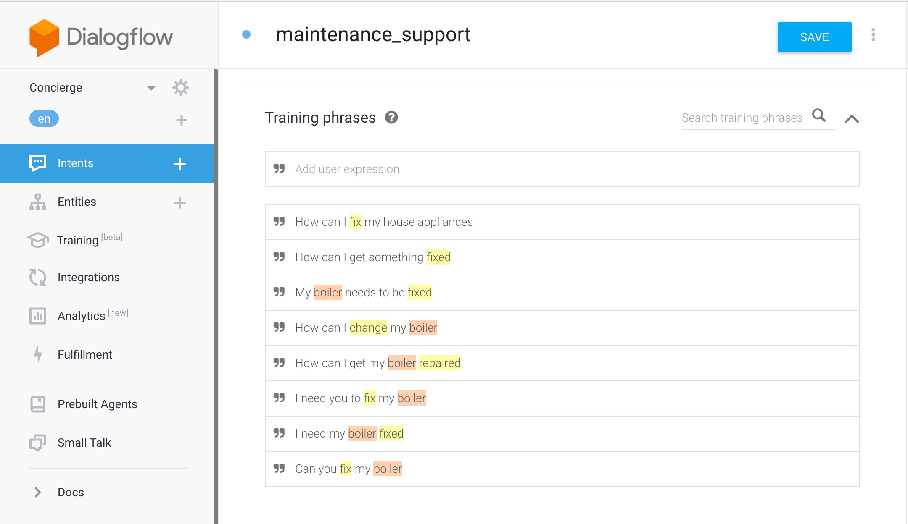
NLP: DIALOGFLOW
Intent Name
Utterances

Slide 12
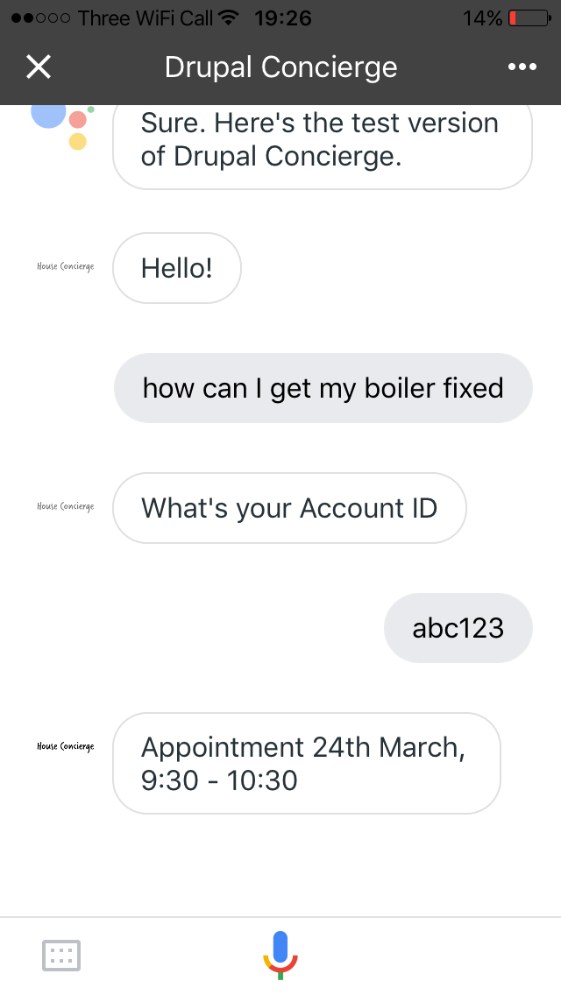
GOOGLE ASSISTANT

Slide 13
NLP and CHATBOTS
NLP
USER
CHATBOT

Slide 14
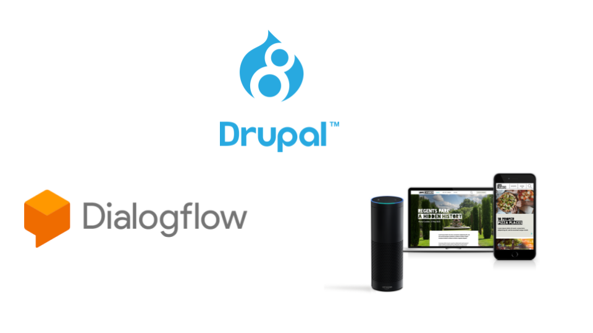

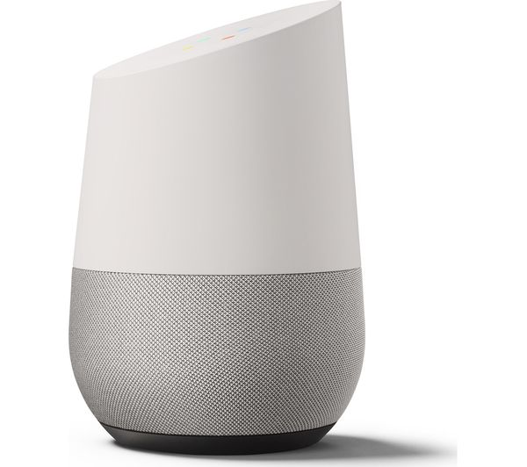




CHATBOT API
Coming soon!

Slide 15
CHATBOT API

Slide 16
CHATBOT API
Features:
Intents are Plugins
Entities from your data.
Views integration
Dialogflow and Alexa integration out-of-the-box. And more coming.
Common flexible layer, for easy integration with custom plaftorms/NLPs/Chatbots

Slide 17
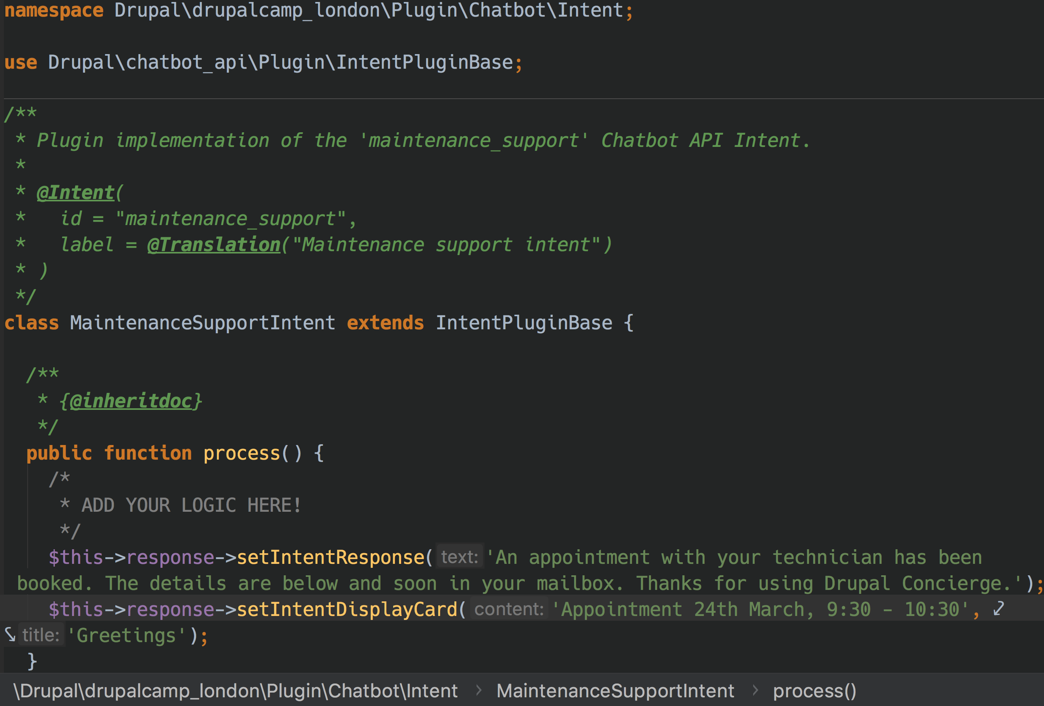
INTENT PLUGIN
Plugin ID = Intent Name
Your Logic
Response

Slide 18
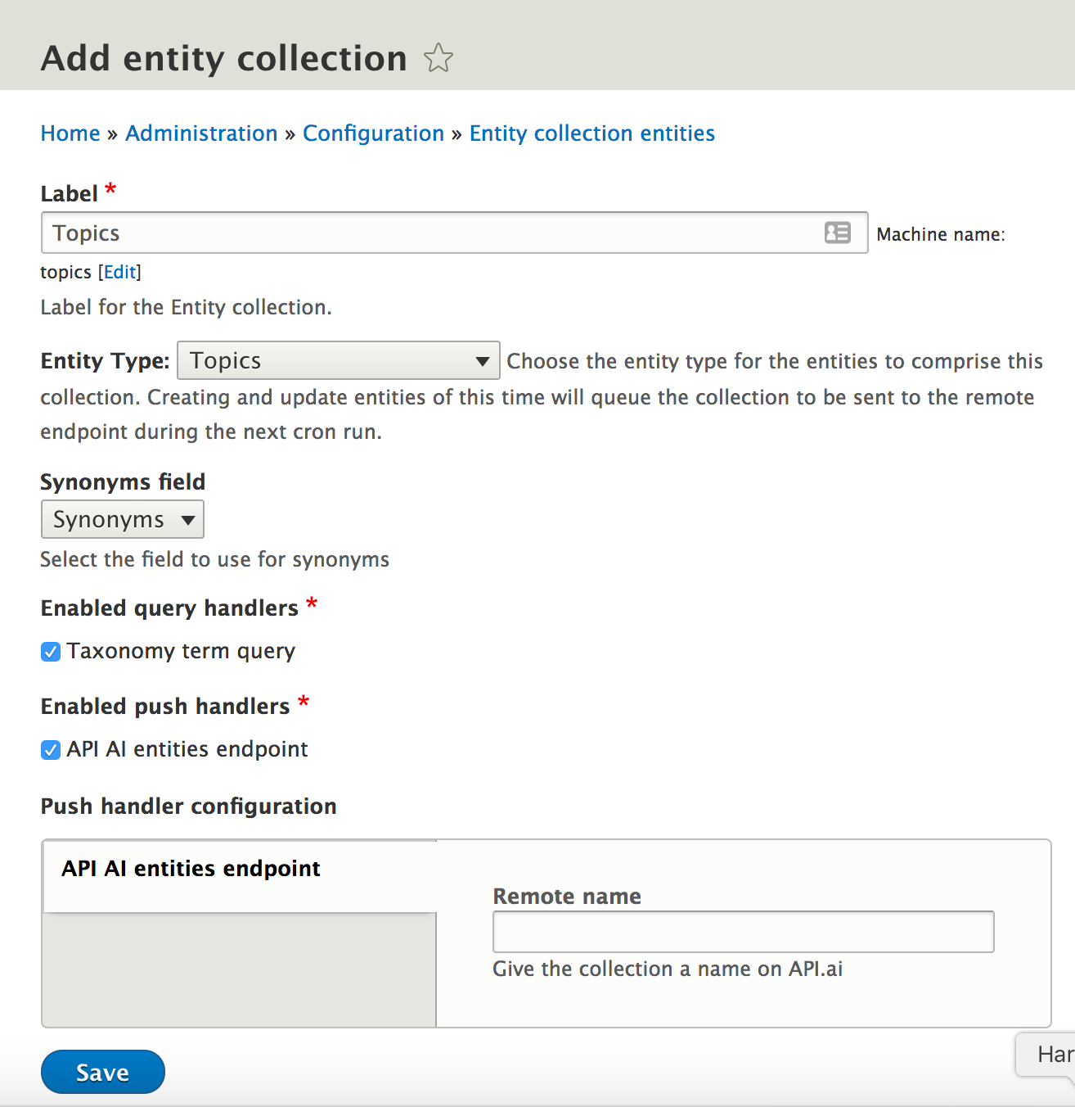
ENTITIES PUSH

Slide 19
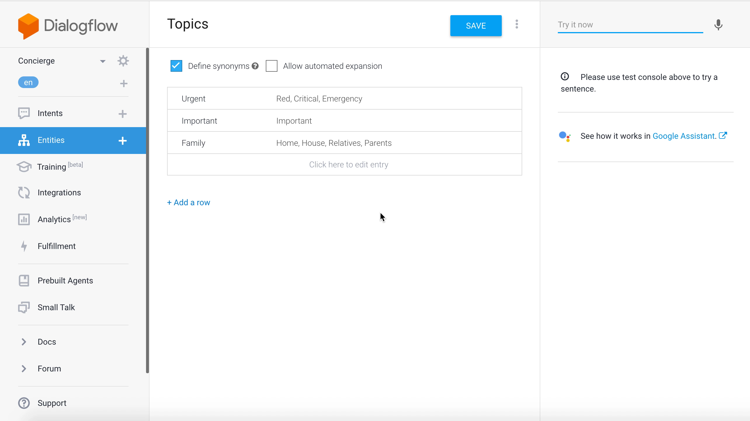
ENTITIES PUSH

Slide 20
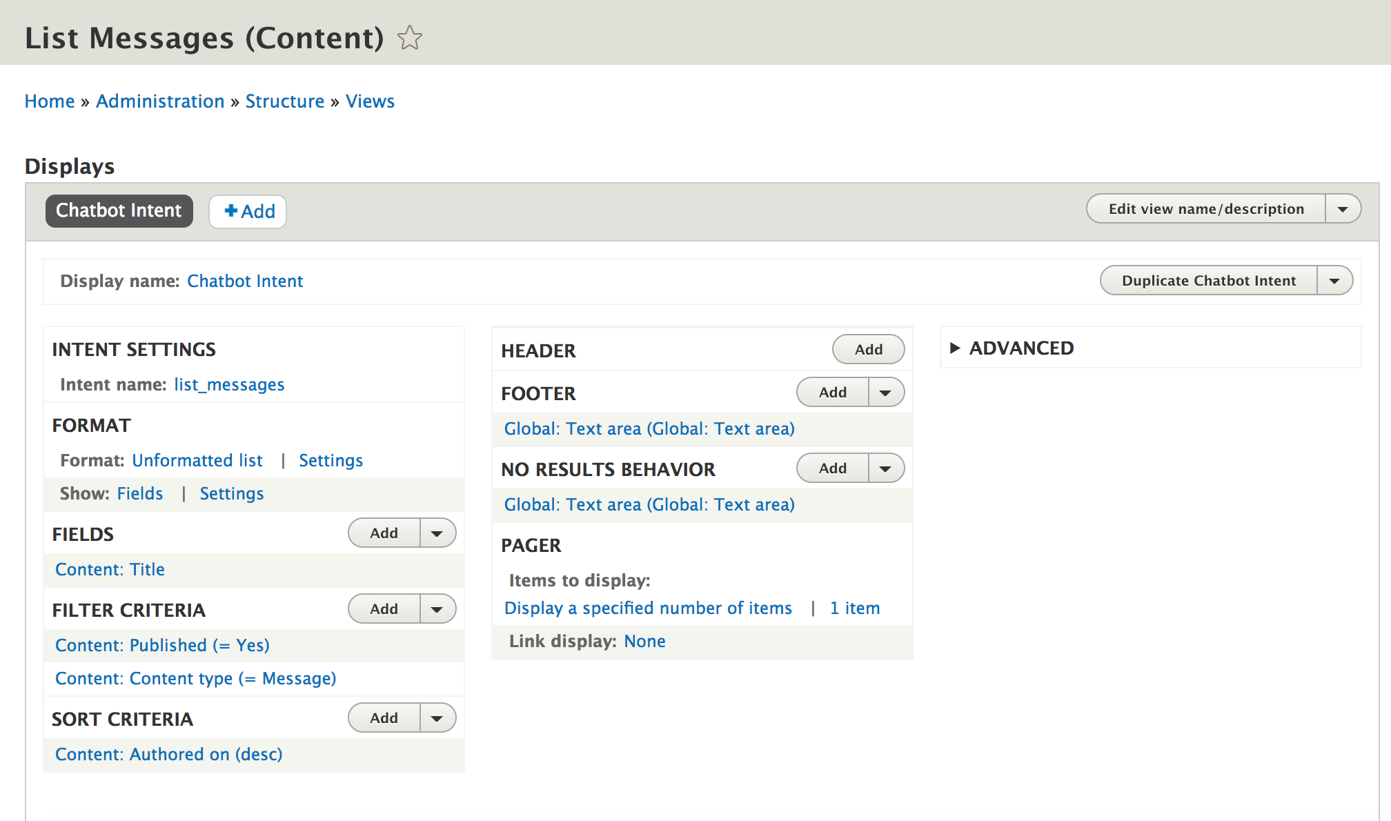
VIEWS INTEGRATION

Slide 21
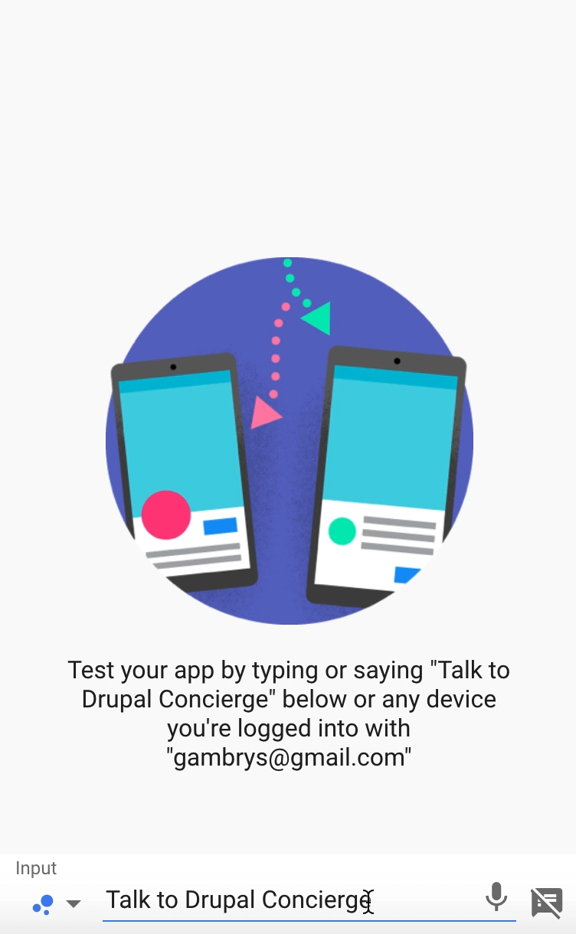
VIEWS INTEGRATION

Slide 22
SERVING YOUR CONTENT
THROUGH A CHATBOT
Plan you intents in advance
For utterances try answerthepublic.com
Train your bot
Built your content with intents in mind
Create a Display Mode for your bot

Slide 23

“Hi, I’m Drupal. How can I help you?”
THANK YOU!
http://dgo.to/chatbot_api https://dialogflow.com/ @gambry LONDON DRUPAL USER GROUP https://www.meetup.com/London-Drupal-User-Group/

